Slide 1





Cell2Cell Customer Retention
Group 2

Slide 2


Addressing Customer Churn in Cell2Cell’s Consumer Business
What Factors and Customers Drive Customer Churn?
High Credit Rating (credita, aa)
Customer Needs
Number of three way calls (threeway)
Married (marryyes)
?
Expected Impact on Customer Retention
Current Equipment Age
(Eqpdays)
Has Made Retention Call (retcall)
Overage Minutes Usage (overage)
Number of dropped or blocked calls (dropblk)
Customer Choice

Slide 3
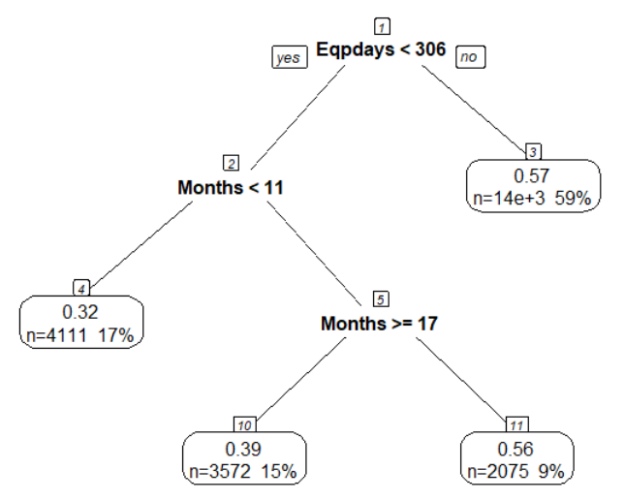
Customer Churn Predictions
Decision Tree Model
Customer churn can be predicted with a 77% true positive rate using just 2 features:
Current Equipment Days
Months of Service
There are 2 leaves that show a >50% likelyhood of churning.
A
B
Customers with relatively older equipment (>306 days)
Customers with new equipment and members between 11 and 17 months
Newish customers that have had to replace their equipment multiple times

Slide 4
Model Evaluations
Decision Tree
Linear Regression
23%
44%
43.6%
57.6%
77%
56%
56.4%
42.4%
Churn
Stay
Churn
Stay

Slide 5
Model Comparisons ie. reasons why we chose the model that we did
True Positive rate
>>>>>>>>>>>
Interpretability
>>>>>>>>>>>
Profit
>>>>>>>>>>>>
Other
>>>>>>>>>>>>>

Slide 6
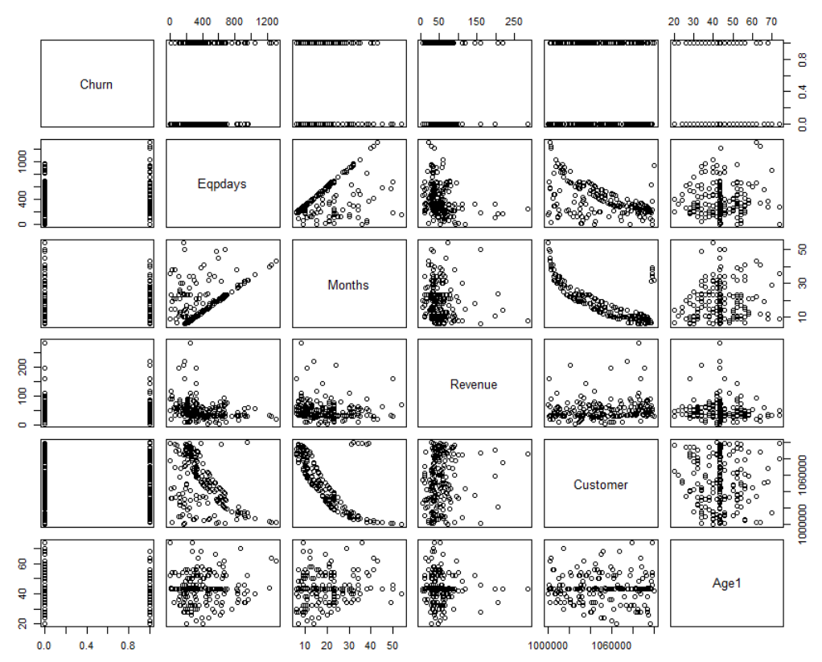
R script outputs
Churn "Has the customer churned
during month (1=Yes, 0=No)"
Eqpdays "Number of days of the
current equipment"
Months "Months in Service"
Recchrge "Mean total recurring charge"
Revenue "Mean monthly revenue"
Csa "Communications Service Area"
Customer "Customer ID"
Age1 "Age of first HH member"
Age2 "Age of second HH member"
Mailflag "Has chosen not to be solicited
by mail"
Retcall "Customer has made call to
retention team"

Slide 7
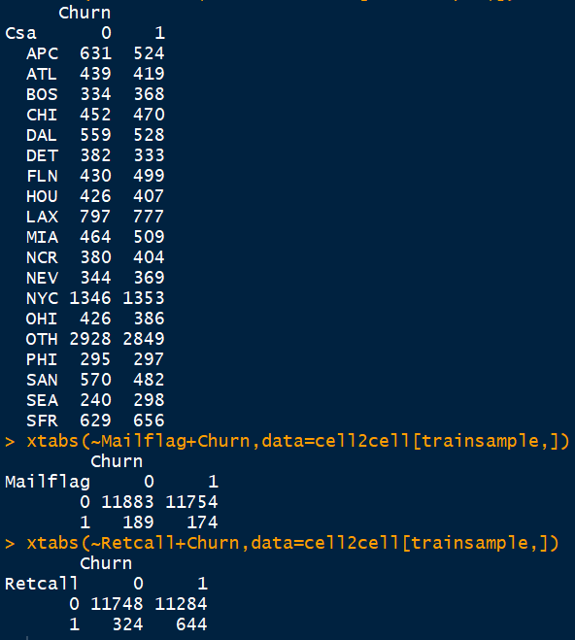
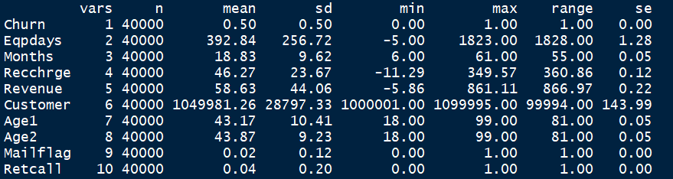
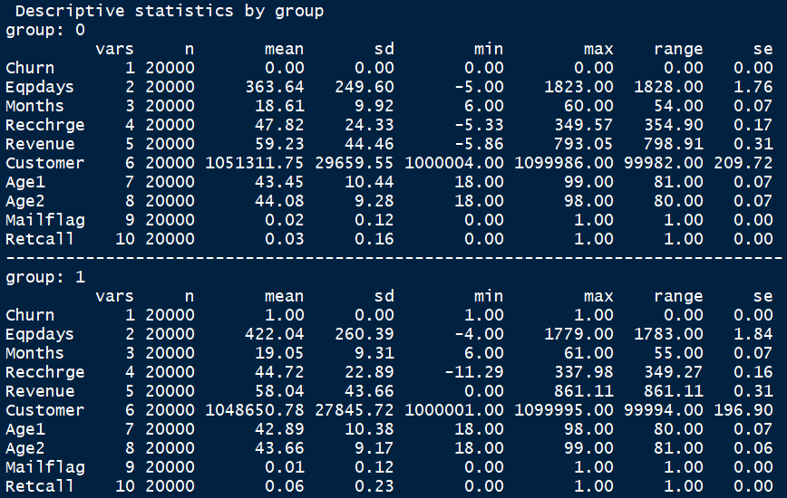
R script outputs

Slide 8
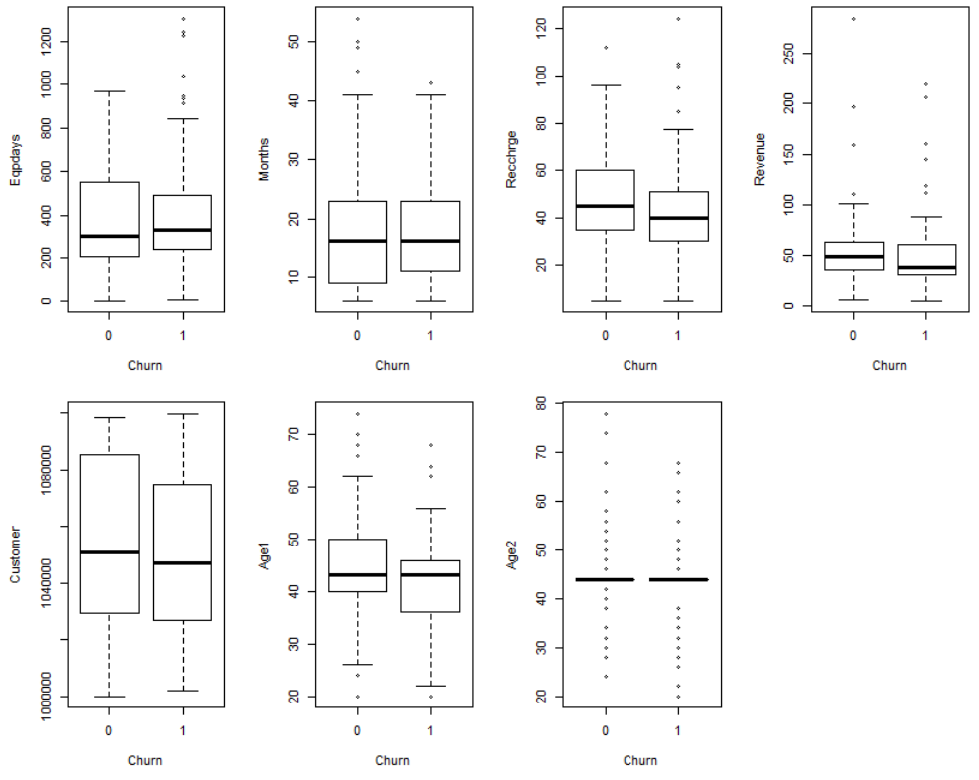
R script outputs

Slide 9
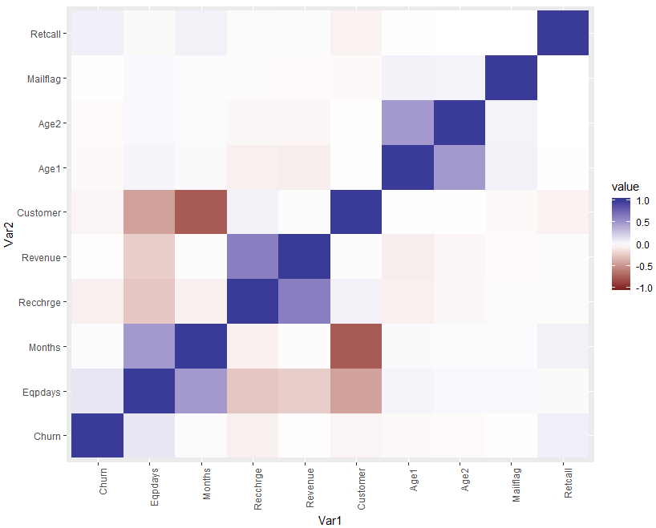
R script outputs

Slide 10
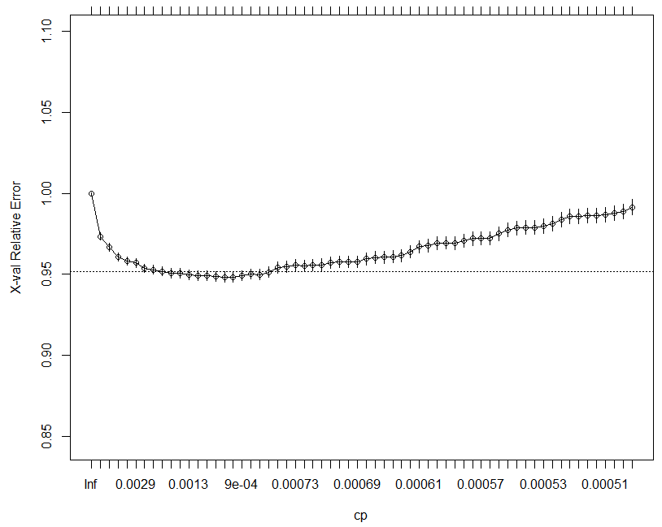
R script outputs – Tree cp vs error

